Slide 1
CERN OPENLAB · CMS LEVEL-1 TRIGGER · ANOMALY DETECTION R&D
Presentation 4
External Higgs Signals and
Latent-Space Model Selection
Comparing a balanced representation model and an anomaly-oriented model against
external Higgs-like signals, plus an exploratory VICReg-style check
Model: MHA event encoder, 10-class SM superclass benchmark
Signals: HH4B (trained) · HH, VBFH, ggH (external)
Project update
2026-08-06
Notes:
This is Presentation 4. Since the last update, we broadened the benchmark, tested six loss-objective variants, swept the balanced configuration across latent dimensions, and - the main new piece - evaluated external Higgs-like signals (HH, VBFH, ggH) that were never used in training, alongside the trained HH4B class. We also ran an exploratory VICReg-style objective as a further check. Everything in this deck uses real numbers from the analysis reports and the unified experiment CSV - nothing is estimated.

Slide 2
MOTIVATION
01 / 14
Anomaly detection at L1, not only classification
● This project is about anomaly detection at L1 trigger level, not only classification.
● The goal is to learn a latent representation of L1-only event information that can help identify rare or unseen signals.
● Current focus: understand how HH4B and external Higgs-like samples behave in latent space.
Notes:
The framing for all of this work is anomaly detection, not classification accuracy. We're trying to learn a latent representation from L1-only event information - so no offline reconstruction - that would help flag rare or unseen physics signals at trigger level. The current focus is specifically on how HH4B, which we do train on, and a set of external Higgs-like samples we never train on, behave once they're mapped into that latent space.

Slide 3
WHAT CHANGED SINCE THE PREVIOUS PRESENTATION
02 / 14
Five new pieces of work since Presentation 3
● Broader label set: 5-class HH4B setup → 10-class SM superclass setup.
● Objective sweep: evaluated 6 objective/model configurations.
● Capacity sweep: re-ran the best balanced configuration at latent_dim = 32, 64, 128.
● External signal evaluation (new): added HH, VBFH, ggH, evaluated alongside the trained HH4B class.
● Exploratory objective (new): added VICReg-style representation-learning tests.
10-CLASS SM SUPERCLASS BENCHMARK
MinBias
QCD
DY
Top
W+jets
WW
WZ
ttW
ttZ
HH4B (trained target)
EXTERNAL HIGGS SIGNALS TESTED
HH (external)
VBFH (external)
ggH (external)
HH4B (trained reference)
Never used in training — mapped into the 10 trained classes above.
Notes:
Five things changed since the last presentation. We broadened the label set to ten SM superclasses instead of five - shown on the right, with HH4B as the trained anomaly target. We tested six different loss-objective configurations on that broader set. We re-ran the best-performing balanced configuration at three latent dimensions to check whether more capacity helps. And the two new pieces: we evaluated external Higgs-like samples - HH, VBFH, ggH, shown in the lower card - that were never part of training, alongside the trained HH4B class as a reference point. We also added an exploratory VICReg-style objective as a further representation-learning check.

Slide 4
SIX 10-CLASS MODEL CONFIGURATIONS
03 / 14
Objective choice, not just capacity, drives the spread
All at latent_dim=64, ff_dim=128, heads=8, 2 blocks, mean pooling, linear head, 100k events/class
CONFIGURATION | ACCURACY | MACRO F1 | HH4B F1 | EVAL-QUALITY | EFF. RANK | HEAD-FISHER RANK
Label smoothing 0.05 + var | 0.4747 | 0.4677 | 0.5613 | 0.00004 | 11.17 | 79.63
Focal γ=2 + var | 0.4600 | 0.4543 | 0.5567 | 0.1476 | 8.08 | 51.63
CE + SupCon 0.05 + var ★ balanced | 0.4602 | 0.4560 | 0.5612 | 0.2207 | 2.84 | 23.87
CE + var + Cov 0.001 ★ anomaly-oriented | 0.4556 | 0.4468 | 0.5566 | 0.2294 | 29.12 | 445.55
CE + SupCon 0.10 + var | 0.4662 | 0.4580 | 0.5609 | 0.1937 | 3.57 | 22.14
CE + var + Cov 0.005 | 0.4716 | 0.4644 | 0.5599 | 0.1318 | 27.47 | 254.24
⚠ A plain “CE + variance only” 10-class run is not available in this comparison — all six rows add a further regularizer on top of CE + variance.
● Balanced (CE+SupCon 0.05+var) and anomaly-oriented (CE+var+Cov 0.001) are the two configurations carried forward to the external-signal evaluation.
● HH4B F1 is nearly flat across all six (0.557-0.561) — accuracy and eval-quality vary far more than HH4B F1 does.
Notes:
These are the six 10-class objective variants, all at latent_dim=64, with only the loss function changed. Source: the unified experiment CSV plus the July 31 loss-objective comparison note. HH4B F1 barely moves across all six, but eval-quality and effective rank swing enormously - eval-quality goes from essentially zero with label smoothing to 0.229 with covariance regularization at 0.001. That's the strongest evidence we have that the objective, not the label set or capacity, is the main lever on latent geometry. The two rows highlighted are the ones we carry forward: SupCon 0.05 as the balanced candidate, covariance 0.001 as the anomaly-oriented one.

Slide 5
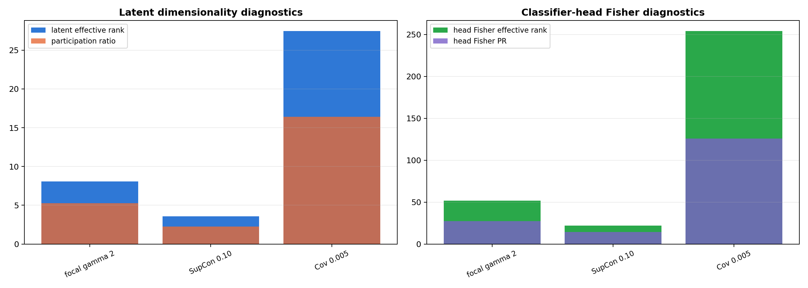
EFFECTIVE RANK FOR THE SIX CONFIGURATIONS
04 / 14
The objective function strongly affects latent-space usage
● Effective rank measures how many latent directions are actively used by the representation.
● Head-Fisher effective rank measures how many classifier-head directions are important for the task.
● All six configurations share the same latent_dim=64 — yet effective rank ranges from 2.84 to 29.12, roughly a 10x spread, from objective choice alone.
● Higher nominal latent dimension does not automatically mean better anomaly detection — see the latent_dim sweep on the next slide.
LATENT & HEAD-FISHER DIMENSIONALITY
analysis/figures/superclass_loss_objective_comparison/loss_objective_latent_head_fisher_available.png
⚠ Figure covers only 3 of 6 variants (focal, SupCon 0.10, Cov 0.005) — not full coverage.
Notes:
Two complementary diagnostics: effective rank from PCA on the latent covariance, and head-Fisher effective rank from a Fisher approximation on the classifier head. The headline number: at the exact same latent_dim=64, effective rank spans 2.84 to 29.12 depending only on which objective was used. That's roughly a ten-times spread from the loss function alone. The figure on the right is the existing comparison plot, but it only has data for three of the six variants - focal, SupCon 0.10, and covariance 0.005 - so don't present it as full coverage.

Slide 6
BEST BALANCED CONFIGURATION SWEEP: LATENT_DIM 32 / 64 / 128
05 / 14
More capacity did not clearly improve the representation
CE + SupCon 0.05 + variance · 100k events/class · same architecture otherwise
LATENT_DIM | ACCURACY | MACRO F1 | HH4B F1 | EFF. RANK | PARTIC. RATIO | EVAL-QUALITY
32 | 0.4687 | 0.4634 | 0.5639 | 5.049 | 3.386 | 0.1594
64 | 0.4734 | 0.4695 | 0.5593 | 4.448 | 2.778 | 0.00004
128 | 0.4675 | 0.4613 | 0.5615 | 1.511 | 1.169 | 0.2253
● This sweep was requested to check whether more latent capacity improves the representation.
● Effective rank decreased as latent_dim increased (5.05 → 4.45 → 1.51) — the opposite of the naive expectation.
● eval-quality collapsed near zero at latent_dim=64 (0.00004), then recovered at 128 — a non-monotonic pattern similar to instabilities seen in earlier sweeps.
● HH4B F1 stayed essentially flat (0.559-0.564) across all three — capacity alone did not change anomaly-relevant classification.
EFFECTIVE RANK VS. LATENT_DIM
⚠ eval-quality is highly non-monotonic here — treat as an unresolved instability, not a settled trend.
Notes:
This directly tests whether giving the model more latent room helps. It doesn't, at least not cleanly: effective rank actually goes down as latent_dim goes from 32 to 128, and eval-quality nearly vanishes at 64 before recovering at 128. HH4B F1 barely moves at all. So capacity is not the lever - consistent with what we found for the objective comparison on the previous slide. The eval-quality collapse at 64 needs a repeat run before we read anything into it.

Slide 7
EXTERNAL HIGGS SIGNAL EVALUATION SETUP
06 / 14
Testing signals the model has never seen in training
● External Higgs-like samples evaluated: HH, VBFH, ggH — plus trained HH4B as reference.
● These samples are evaluated as signals against the 9-class SM background (minbias, qcd, dy, top, wjets, ww, wz, ttw, ttz).
● For unseen samples, classifier response is not accuracy — there is no ground-truth label to score against. It shows how the model maps them into known trained classes.
● Both matter: anomaly score (latent-space geometry) and classifier response (class mapping) capture different things and can disagree.
Notes:
HH4B is a trained class, so we have a real recall/tag-rate number for it. HH, VBFH, and ggH are external - the model has never seen them in training, so there's no accuracy to report for them. What we can report is where the classifier maps them among the trained classes, and separately, how far they sit from the SM background in latent-space geometry. Those two views don't always agree, which is exactly why we look at both.

Slide 8
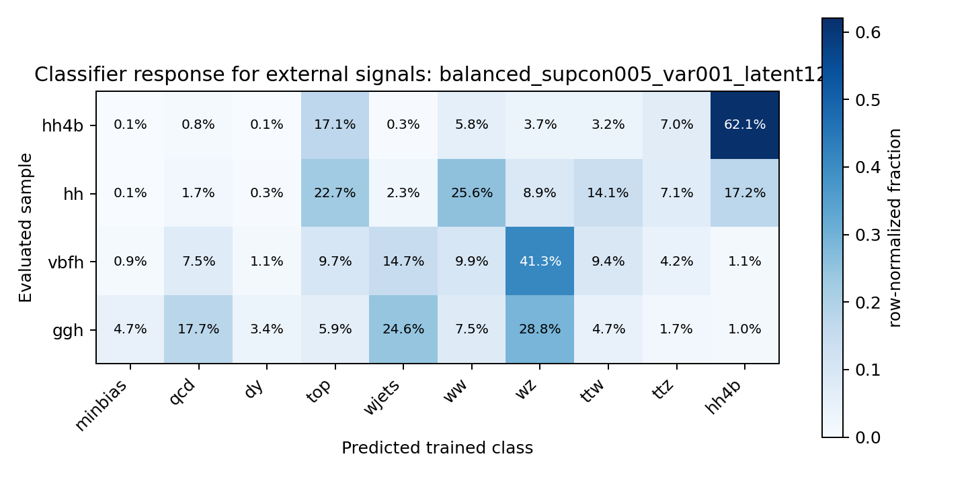
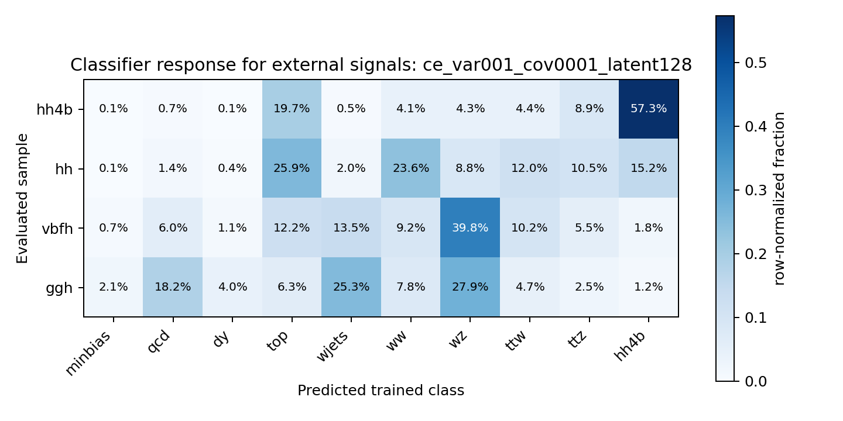
10-CLASS MODEL: EXTERNAL HIGGS CLASSIFIER RESPONSE
07 / 14
Balanced vs. anomaly-oriented objective
BALANCED: CE + SUPCON 0.05 + VAR
ANOMALY-ORIENTED: CE + VAR + COV 0.001
runs/2026-08-04/sm_superclasses_balanced_supcon005_var001_100k_latent128/figures/external_classifier_response/classifier_response_matrix.png
runs/2026-08-05/sm_superclasses_ce_var001_cov0001_100k_latent128/figures/external_classifier_response/classifier_response_matrix.png
SIGNAL | TOP CLASS (BAL.) | HH4B TAG (BAL.) | TOP CLASS (ANOM.) | HH4B TAG (ANOM.)
hh4b (trained) | hh4b | 0.6205 | hh4b | 0.5730
hh | ww | 0.1725 | top | 0.1520
vbfh | wz | 0.0115 | wz | 0.0180
ggh | wz | 0.0100 | wz | 0.0125
Notes:
Both models are latent_dim=128, both 10-class. For trained hh4b, the balanced model tags it correctly 62% of the time versus 57% for the anomaly-oriented model. For the external signals: hh partially maps toward hh4b-like behavior under both models but its dominant class differs - ww for balanced, top for anomaly-oriented. vbfh and ggh both land mostly on wz under both models, with HH4B tag rates around 1-2% - essentially not recognized as HH4B-like by either model's classifier head.

Slide 9
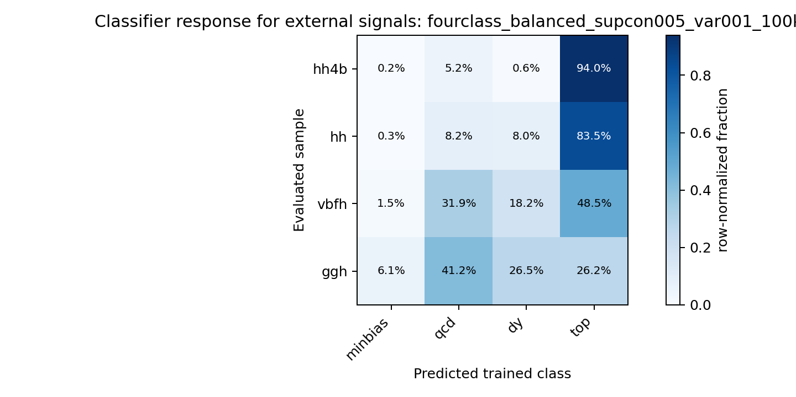
4-CLASS VS. 10-CLASS COMPARISON
08 / 14
Only the 10-class model has a trained HH4B output node
4-CLASS MODEL (MINBIAS, QCD, DY, TOP) — CLASSIFIER RESPONSE
SIGNAL | TOP MAPPED CLASS | TOP FRACTION | HH4B TAG RATE | MEAN HH4B PROB.
hh4b | top | 0.9400 | not available | not available
hh | top | 0.8350 | not available | not available
vbfh | top | 0.4850 | not available | not available
ggh | qcd | 0.4125 | not available | not available
● The 4-class model is trained only on minbias, qcd, dy, top — it has no HH4B output node.
● HH4B, HH, and VBFH are all mostly mapped into Top; ggH mostly into QCD.
● The 10-class model can directly test whether HH-like signals activate an HH4B output; the 4-class model structurally cannot.
runs/2026-08-06/fourclass_balanced_supcon005_var001_100k_latent128/figures/external_classifier_response/classifier_response_matrix.png
Also see: .../fourclass_.../figures/external_classifier_response/classifier_mean_probability_matrix.png
Notes:
This is the structural comparison. The 4-class model was trained before HH4B existed as a category, so it has nowhere to put HH4B-like events except into the four SM classes it knows. Every Higgs-like sample, including the trained-elsewhere HH4B itself, gets pushed mostly into Top, and ggH mostly into QCD. There's no HH4B tag rate to report for this model - it's not available, not zero, because the output simply doesn't exist. This is the structural reason we moved to the 10-class setup.

Slide 10
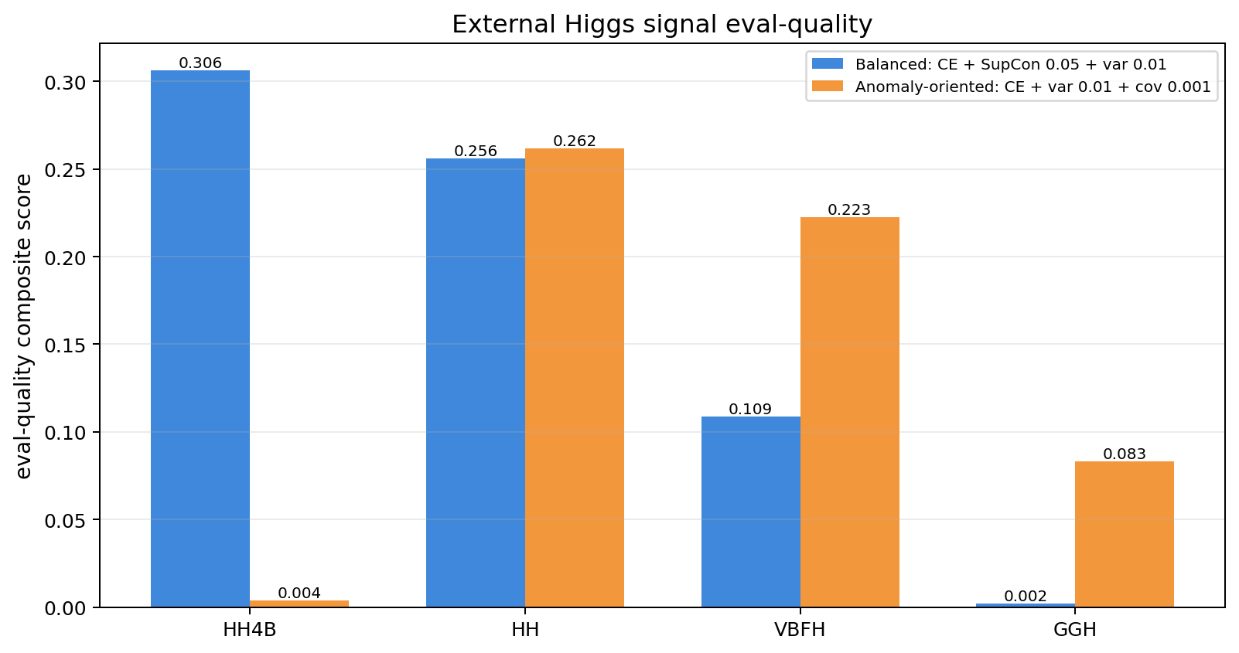
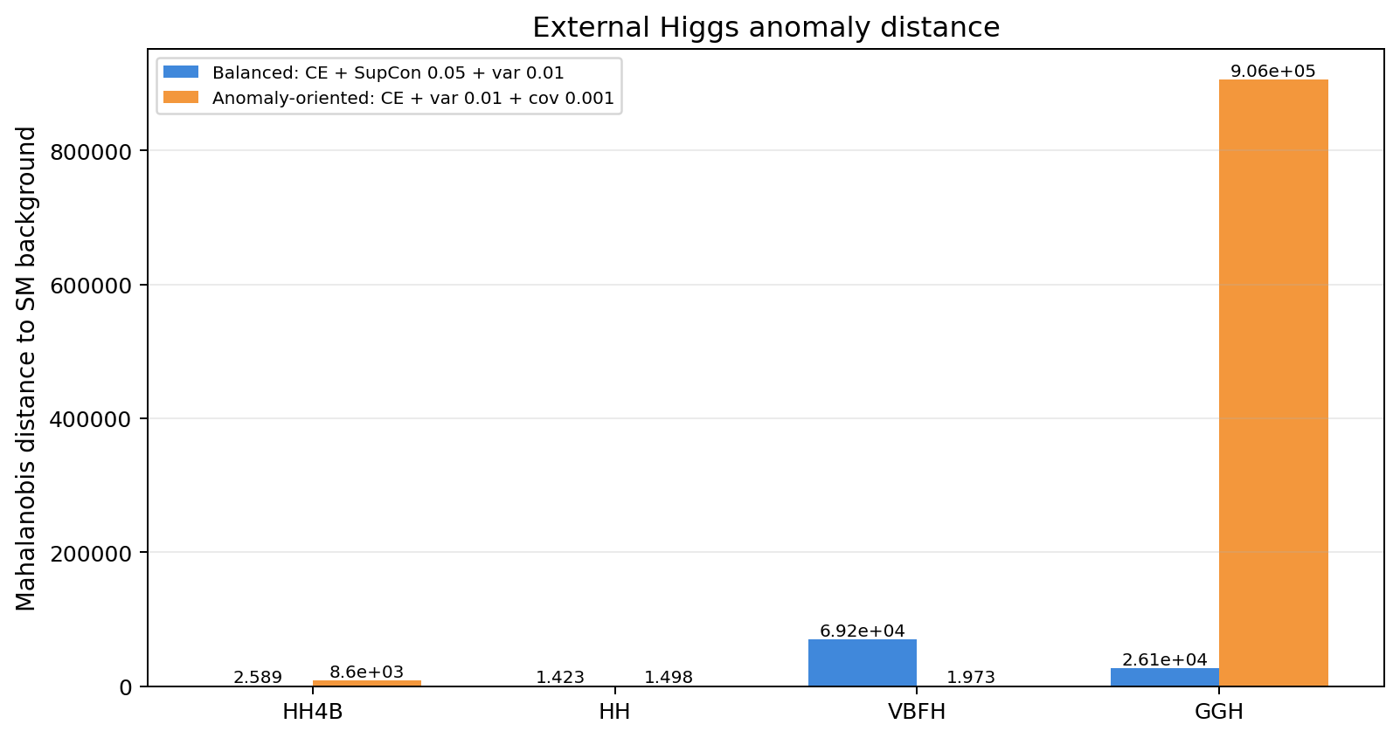
ANOMALY SCORE VIEW
09 / 14
Classifier response and anomaly score can disagree
EVAL-QUALITY SCORE
MAHALANOBIS DISTANCE
● The anomaly score is evaluated through latent-space geometry (Mahalanobis distance, GMM gap, composite eval-quality).
● hh4b eval-quality: 0.306 (balanced) vs. 0.0036 (anomaly-oriented) — despite its name, the anomaly-oriented model scores trained HH4B lower on this composite metric.
● ggh Mahalanobis: 9.06×10⁵ under the anomaly-oriented model — far larger distance from background than any other signal/model pair.
● This disagreement is exactly why classifier response alone is not enough for an anomaly-detection project.
analysis/figures/external_higgs_signal_eval/external_higgs_eval_quality_score.png
analysis/figures/external_higgs_signal_eval/external_higgs_mahalanobis.png
Also available: external_higgs_gmm_gap_log.png, external_higgs_eval_quality_subscores_heatmap.png (analysis/figures/external_higgs_signal_eval/)
Notes:
This is the geometric side of the story. The composite eval-quality score for trained hh4b is much higher under the balanced model than the anomaly-oriented one, which is counter to what the name 'anomaly-oriented' suggests. But ggH gets an enormous Mahalanobis distance under the anomaly-oriented model - far larger than anything else in either model. So the two models separate signals differently, and neither view alone tells the full story. This is the core argument for looking at both classifier response and anomaly-score geometry together.

Slide 11
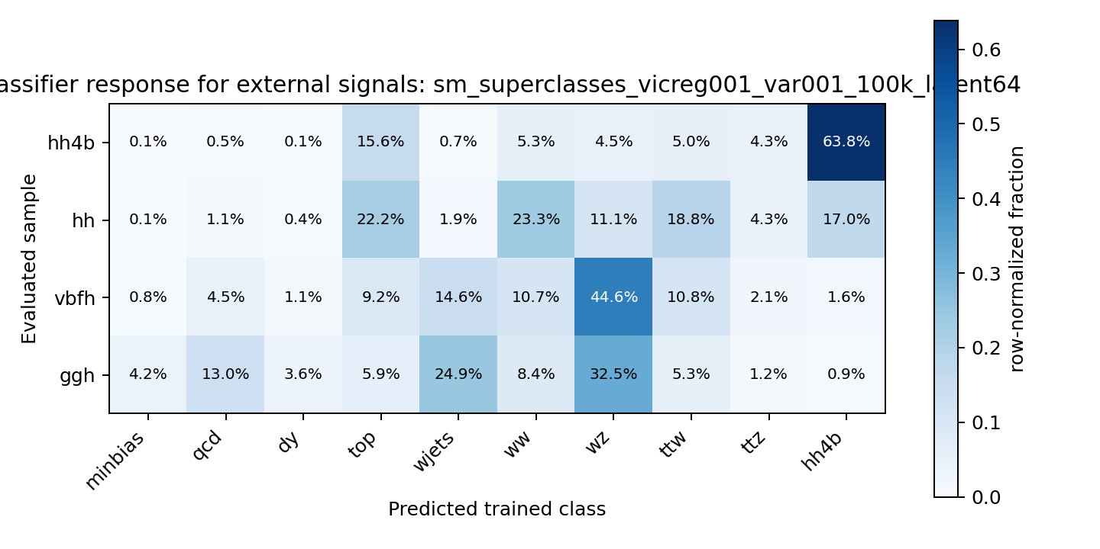
VICREG-STYLE EXPLORATORY TEST
10 / 14
Promising for trained HH4B, not yet for external signals
METRIC | LATENT_DIM=64 | LATENT_DIM=128
HH4B tag rate (trained) | 0.6385 | 0.5915
HH tag rate (external) | 0.1695 | 0.1505
VBFH tag rate (external) | 0.0155 | 0.0125
ggH tag rate (external) | 0.0095 | 0.0100
HH4B eval-quality (geometry) | 0.1098 | 0.1702
Effective rank | 7.23 | 6.31
Head-Fisher effective rank | 61.05 | 89.22
VICREG LATENT_DIM=64 — CLASSIFIER RESPONSE
runs/2026-08-06/sm_superclasses_vicreg001_var001_100k_latent64/figures/external_classifier_response/classifier_response_matrix.png
● VICReg latent_dim=64 gives the highest trained-HH4B tag rate of any model evaluated (0.6385), ahead of both the balanced and anomaly-oriented 10-class models.
● It does not yet clearly make HH, VBFH, or ggH map to HH4B — external tag rates remain low, similar to the other models.
● Promising but not yet the main selected model — kept as an additional exploratory check.
Notes:
VICReg-style is a further exploratory objective, tested at two latent dimensions. The standout number is the trained-HH4B tag rate at latent_dim=64: 0.6385, the highest of any model we've evaluated so far in this deck, ahead of both the balanced and anomaly-oriented 10-class models. But that improvement doesn't carry over to the external signals - HH, VBFH, and ggH still mostly don't map to HH4B, at similar rates to what we saw before. So this is a promising direction worth continuing, not yet a replacement for the two main candidates.

Slide 12
MAIN FINDINGS
11 / 14
Main findings
● The 10-class setup is more realistic for anomaly detection than the earlier 4-class setup — it can directly test whether HH-like signals activate an HH4B output.
● More granular/broader labels activate more latent structure than the original coarse setup (consistent with the effective-rank spread seen across objectives).
● External Higgs signals do not all behave like trained HH4B at L1.
● HH shows partial overlap with HH4B-like behavior (tag rate ~0.15-0.23 depending on model).
● VBFH and ggH are consistently mapped to the WZ electroweak-like background class under both 10-class models (tag rates ~1-2%).
● Balanced (CE + SupCon 0.05 + variance) remains the most stable main candidate across metrics.
● Covariance-regularized and VICReg-style models are useful anomaly-geometry comparisons, each strong on different metrics.
Notes:
Pulling it together: the move to 10 classes is structurally necessary for this to be an anomaly-detection study at all, since the 4-class model literally cannot express an HH4B-like output. Across every comparison in this deck, the objective function - not label granularity or latent capacity alone - is the strongest lever on latent geometry. HH shows partial overlap with HH4B, but VBFH and ggH consistently land on WZ-like background under every model we've tried, including VICReg. The balanced SupCon configuration stays our most stable candidate; the other two are valuable comparisons, not competitors ready to replace it yet.

Slide 13
CURRENT INTERPRETATION
12 / 14
Selection should balance four things, not one
● For anomaly detection, the model should not be selected only by accuracy or HH4B F1.
● The best configuration should balance: classifier response, external-signal behavior, latent-space geometry, and anomaly-score separation.
CURRENT BEST WORKING CHOICE
MAIN
CE + SupCon 0.05 + variance
balanced
COMPARISON
CE + variance + covariance
anomaly-oriented
EXPLORATORY
VICReg-style
not yet selected
Notes:
The interpretation we want to land on: pick a model by accuracy or HH4B F1 alone and you'd miss the story on this slide entirely - the covariance and VICReg runs both score worse on those two metrics while doing something genuinely useful geometrically. So the current working split is: SupCon 0.05 as the main balanced candidate, covariance 0.001 kept as an anomaly-geometry comparison, and VICReg as an exploratory direction we're not ready to select yet but that shows real promise on the trained-HH4B tag rate.

Slide 14
NEXT STEPS
13 / 14
Next steps
● Complete external Higgs evaluation for both the 4-class and 10-class models.
● Add more Higgs-related signals if available.
● Compare anomaly-score distributions across external signal groups.
● Continue testing representation objectives such as VICReg / DINO / JEPA-style methods.
● Validate compatibility of the selected representation with future L1/FPGA constraints.
Notes:
Next steps follow directly from the gaps in this deck: the external evaluation isn't complete for every model combination yet, we only have four Higgs-like signal groups and more would help, we haven't yet systematically compared anomaly-score distributions across signal groups side by side, and representation-objective testing continues beyond VICReg. Longer term, whatever representation we settle on needs to be checked against L1/FPGA resource constraints, not just offline metrics.

Slide 15
BACKUP / REFERENCES
14 / 14
Backup / References
SOURCE REPORTS AND DATA
analysis/2026-08-06_external_higgs_signal_evaluation.md
analysis/2026-07-31_superclass_loss_objective_comparison.md
analysis/2026-07-28_best_config_finding_and_latent_sweep.md
ngt_mha_nodes_aligned_outputs/scale_tests/unified_experiment_summary_complete_only.csv
GITLAB REPOSITORY
https://gitlab.cern.ch/cms-l1-ad/openlab_ss26
Notes:
Backup slide with the exact source paths for everything in this deck, for anyone who wants to check a number directly against the report or the CSV.

